Slide 1

Data Analytics Case Study : Games Sales
Febe Jovita

Slide 2
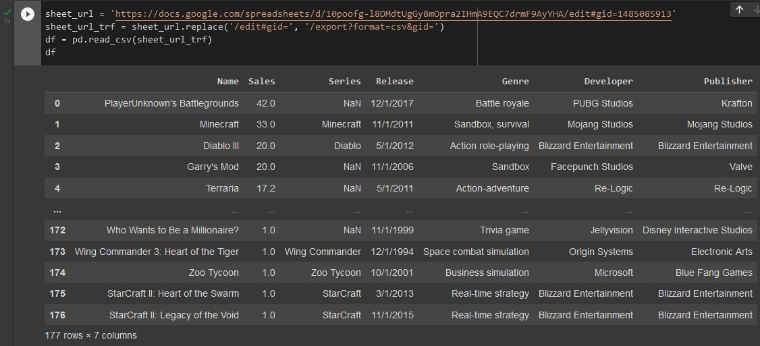
Table of Interest

Slide 3
Questions to be answered
Which game is the oldest and the newest games in that dataset ?
Which publisher published most of the games ?
Which developer developed most of the games ?
Which series is the most sales ?
Which series have the most games ?

Slide 4

Tools

Slide 5
Data Cleaning
Drop Duplicates
df = df.drop_duplicates()
df.info()
Check Empty Values
df.isna().sum()
Change Datatype
df['Release'] = pd.to_datetime(df['Release'], format='%m/%d/%Y')
df.info()
For more details, you can view Jupiter Notebook here https://colab.research.google.com/drive/10gBDuwZ8Fhl6KwzcLBwRtUCM2GU42evV#scrollTo=POwsD2kOoyRn

Slide 6
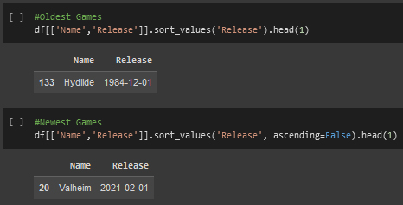
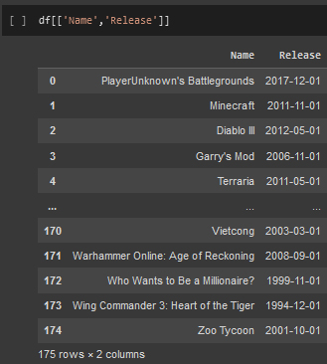
Which game is the oldest and the newest games in that dataset ?
The oldest games is Hydlide and the newest game is Valheim.

Slide 7
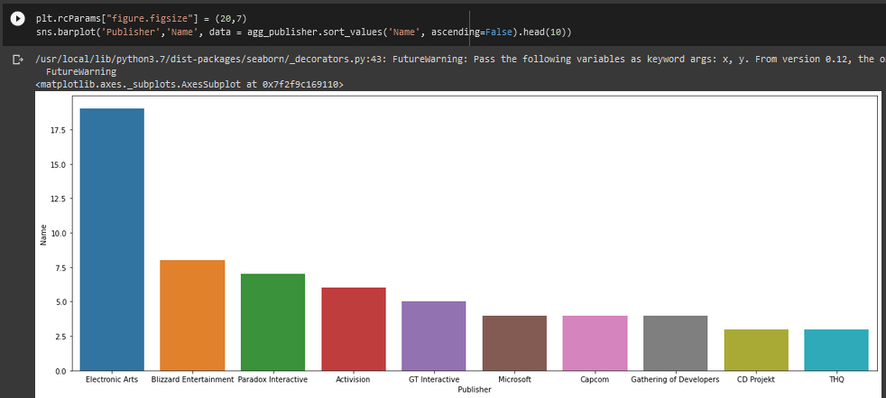
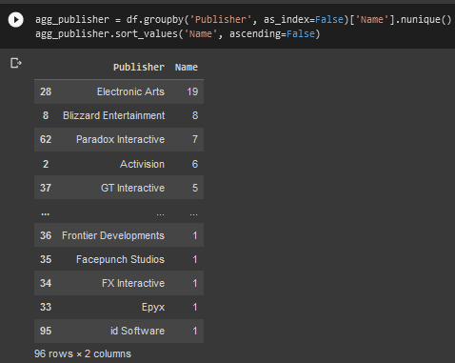
Which publisher published most of the games ?
Electronic Arts with 19 published games.
For more details, you can view Jupiter Notebook here https://colab.research.google.com/drive/10gBDuwZ8Fhl6KwzcLBwRtUCM2GU42evV#scrollTo=POwsD2kOoyRn

Slide 8
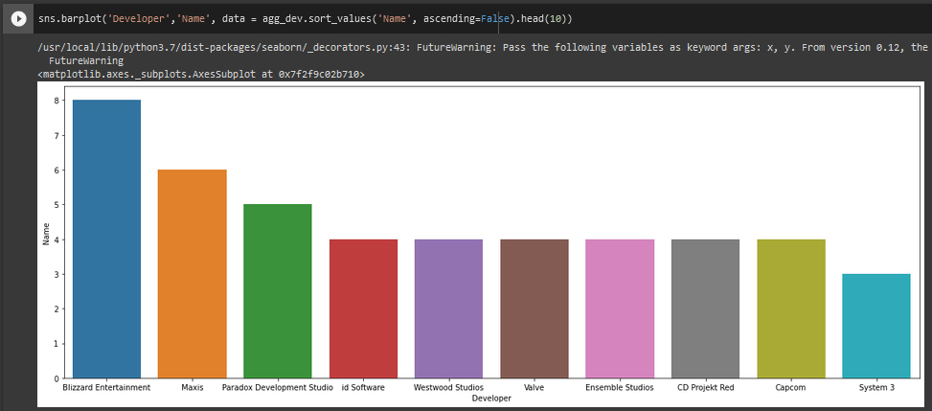
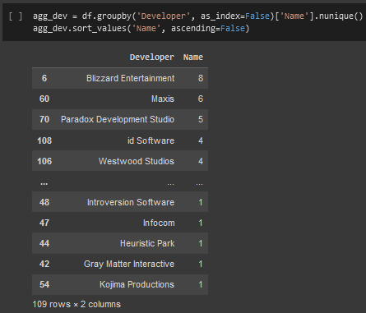
Which developer developed most of the games ?
Blizzard Ent.
For more details, you can view Jupiter Notebook here https://colab.research.google.com/drive/10gBDuwZ8Fhl6KwzcLBwRtUCM2GU42evV#scrollTo=POwsD2kOoyRn

Slide 9
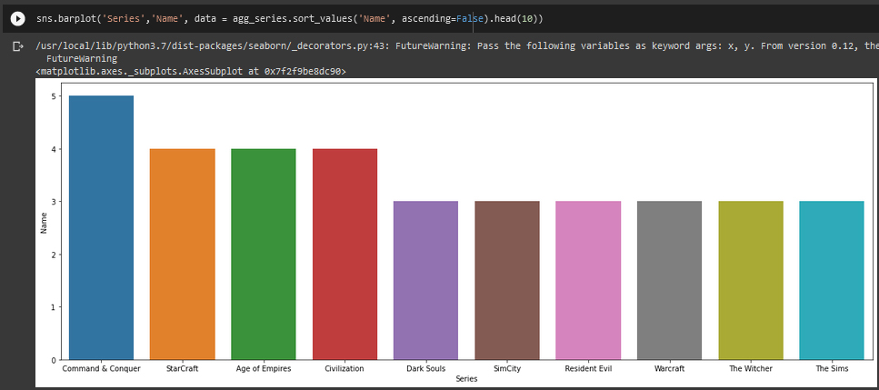
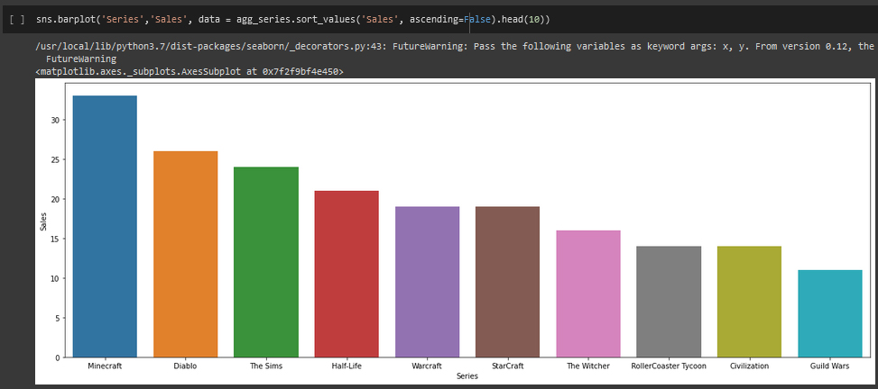
Which series is the most sales ? Which series have the most games ?
Series with most sales is Minecraft and series with most games is Command & Conquer.
For more details, you can view Jupiter Notebook here https://colab.research.google.com/drive/10gBDuwZ8Fhl6KwzcLBwRtUCM2GU42evV#scrollTo=POwsD2kOoyRn

Slide 10
Conclusion
The oldest games is Hydlide and the newest game is Valheim.
The publisher published most of the games is Electronic Arts with 19 published games.
The developer developed most of the games is Blizzard Ent.
Series with most sales is Minecraft and series with most games is Command & Conquer.

Slide 11
Recommendations
Promotion : give attractive promotions to get more gamers.
Championship : organize championships to increase the spirit of gamers.
Sustainable : make many game variants for the best-selling series.
Collaboration : enhance collaboration among developers, publishers and influencers.
Innovation : make many games in metaverse.

Slide 12
Thank You
LinkedIn : www.linkedin.com/in/febe-jovita-7b1572246
Email : febejovita@gmail.com
Instagram : @fjovitaj

